Slide 1


NEXT GEN EMPLOYABILITY PROGRAM
CREATING A FUTURE-READY WORKFORCE
Student Name :
Student College ID :
Krishna Das
21831A05H6
Student Internship ID :
AICTE Student ID: STU6622171ead0651713510174 AICTE Internship ID: INTERNSHIP_173892172667a5d6fed4b6a
College Name :
Guru Nanak Institute Of Technology,Hyderabad

Slide 2
CAPSTONE PROJECT SHOWCASE
Project Title
Recipe Sharing Platform with React and ExpressJS Framework
Abstract | Problem Statement | Project Overview | Proposed Solution | Technology Used | Modelling & Results | Conclusion | Q&A

Slide 3
Abstract
1
The Recipe Sharing Platform is a web application built with React for the frontend and Express.js for the backend, enabling users to share, search, and manage food recipes.
2
Users can register, log in, and authenticate securely, with features like recipe submission, image uploads, and categorization for easy discovery.
3
The platform supports search and filtering by category, dietary preferences, and user ratings, along with a shopping list feature to help users plan ingredients efficiently.
4
With a modern UI, social media sharing, and review system, the application enhances user engagement and provides a seamless recipe-sharing experience.

Slide 4


Problem Statement
Existing recipe platforms lack personalization, advanced filtering, and interactive features like shopping lists and social sharing.
Users face difficulties in organizing, reviewing, and accessing reliable recipe ratings efficiently.
There is no centralized space for food enthusiasts to share and discover home-cooked recipes easily.
The need for a user-friendly and feature-rich platform that allows seamless recipe sharing, exploration, and engagement.

Slide 5

Project Overview
Recipe Sharing Platform is a web application built with React (Frontend) and ExpressJS (Backend) to allow users to share, explore, and manage recipes effortlessly.
Users can register, log in, and submit recipes with images, ingredients, and preparation steps
Advanced features include recipe search, category-based filtering, ratings & reviews, shopping list creation, and social media sharing.
The platform ensures a smooth user experience with an intuitive UI, responsive design, and interactive features, making recipe discovery and sharing engaging and fun.

Slide 6
Proposed Solution
Develop a web-based platform using ReactJS (frontend) and ExpressJS (backend) for seamless recipe sharing.
Implement user authentication for secure login, registration, and profile management.
Enable recipe management where users can add, edit, delete, and view detailed recipes with images.
Provide advanced search & filtering based on category, rating, and dietary preferences.
Introduce ratings & reviews to help users provide feedback and discover top-rated recipes.

Slide 7
Technology used
Frontend: ReactJS, HTML, CSS, JavaScript
Backend: ExpressJS, Node.js
Database: MongoDB
Authentication: JWT (JSON Web Token)
Styling: Tailwind CSS / Bootstrap (optional)
State Management: Context API / Redux (if needed)
Storage: Cloudinary / Firebase for image uploads
API Testing: Postman for testing backend APIs
Version Control: Git & GitHub for source code management

Slide 8
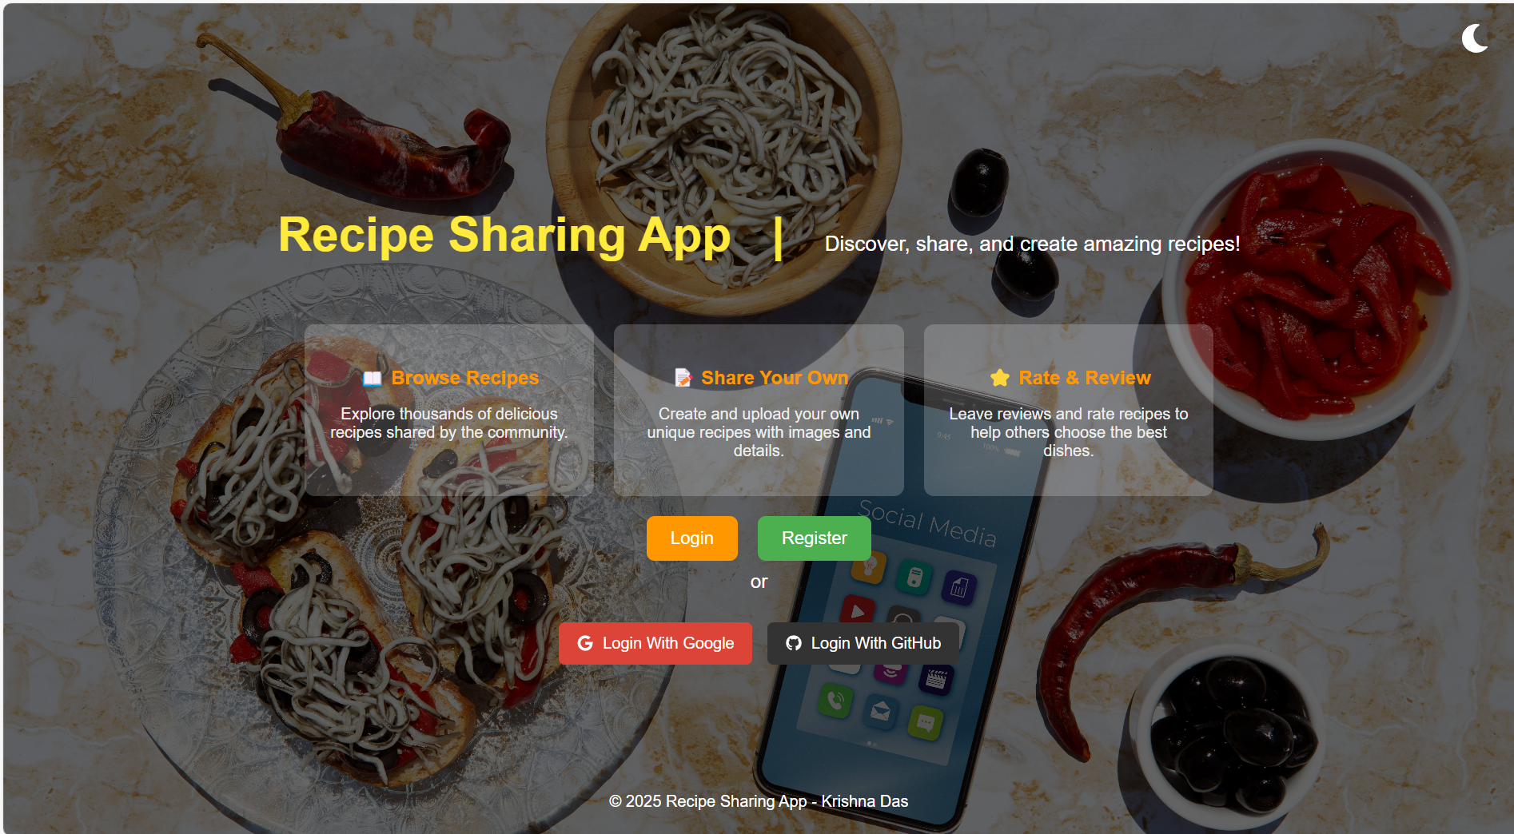
Modelling & Result

Slide 9
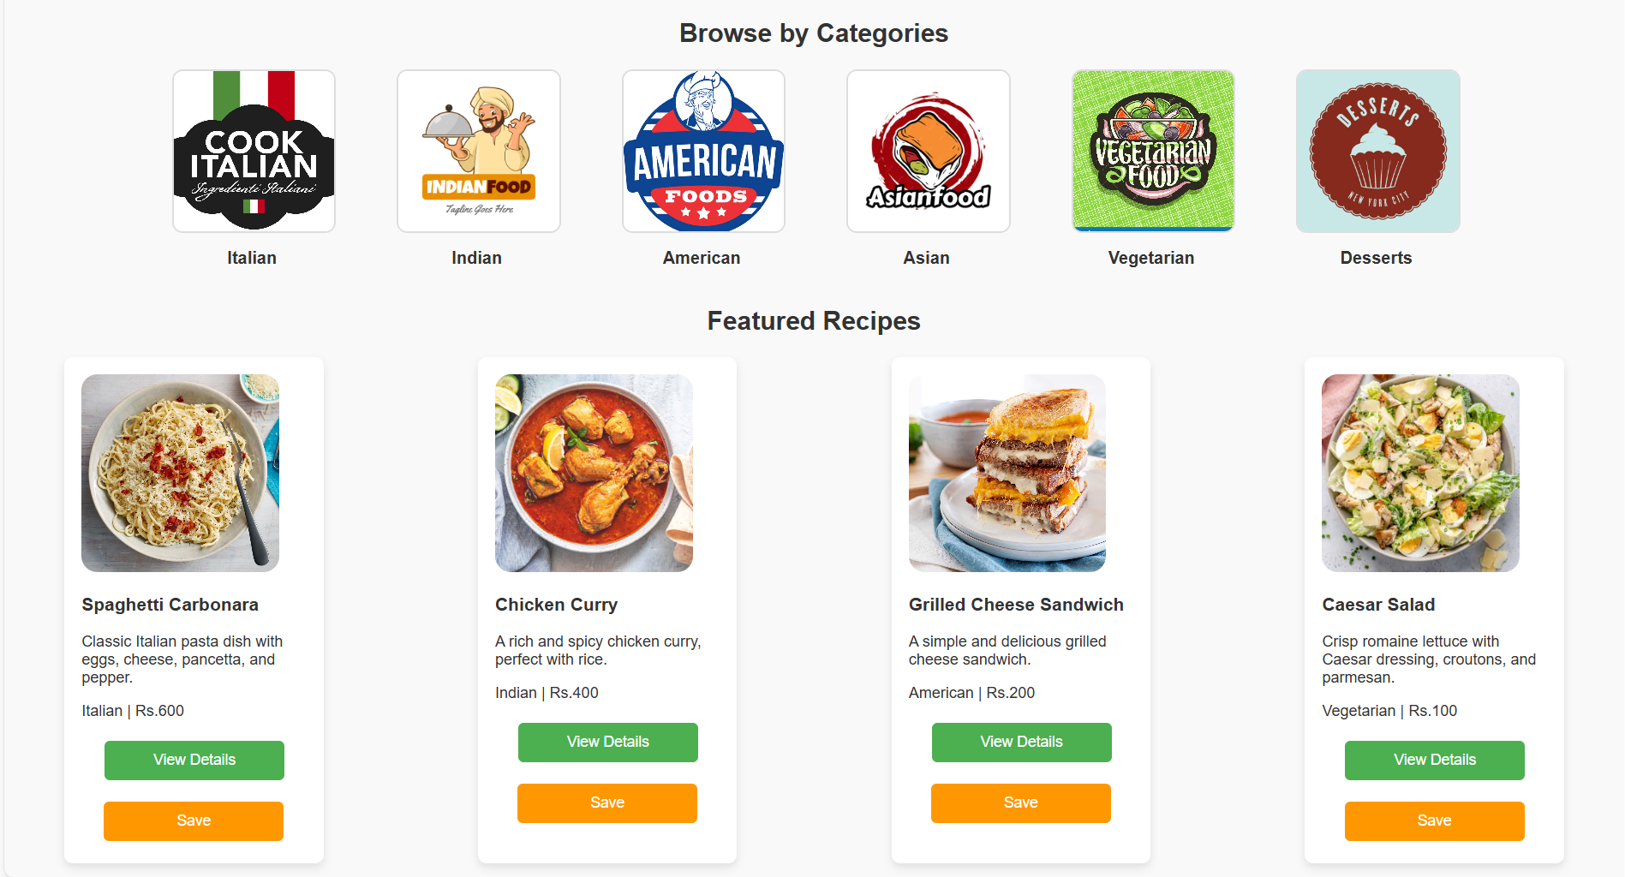
Modelling & Result

Slide 10
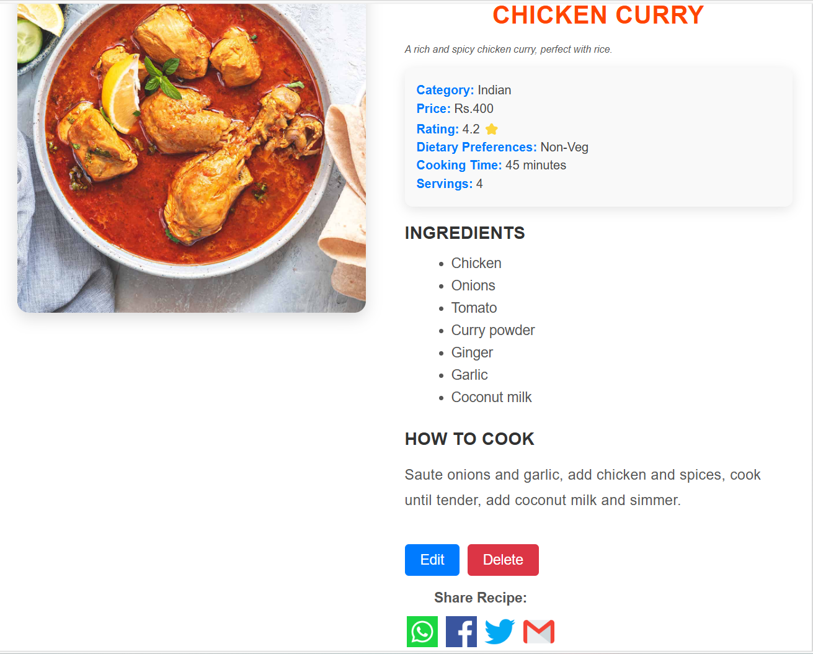
Modelling & Result

Slide 11

Conclusion
The Recipe Sharing Platform provides an interactive space for users to share, explore, and manage recipes efficiently.
With ReactJS for the frontend and ExpressJS for the backend, the platform ensures a seamless and dynamic user experience.
MongoDB stores user data and recipes, while Cloudinary/Firebase manages image uploads for a richer visual experience
Features like authentication, reviews, ratings, and shopping lists enhance user engagement and usability.
This project serves as a scalable and efficient solution for food enthusiasts, encouraging community-driven recipe sharing with modern web technologies.

Slide 12


Notes:
Thank You !!

